Slide 1
第8-1章:蛋白质相互作用 的实验方法和预测
Experimental methods
Prediction of protein-protein interactions

Slide 2
Part I: Experimental Methods
Physical interaction
Yeast two hybrid system
TAP-mass spectrometry
Genetic interaction
SGA
EMAP

Slide 3
Protein-protein interactions (Experimental methods)
Co-immunoprecipitation.
Two-hybrid system (Uetz et al. 2000, Ito et al. 2000, 2001).
Purified Complex by mass spectrometry
TAP: Tandem affinity purification (Gavin et al. 2002).
HMS-PCI: high-throughput mass spectrometric protein complex identification (Ho et al. 2002).
Notes:
There are some experimental methods to detect PPI such as cross-linking, copurification, co-immunoprecipitation and two-hybrid
system, and the interaction data are available in website (MIPS).
Two-hybrid system are high-throughput, they detect genome-wide PPIs.
In our project, we use two-hybrid interaction data from two groups.

Slide 4
Mechanism of two-hybrid system
From: Nature 405, June 15, 2000, 837-846.
Notes:
This picture show the mechanism of yeast two-hybrid system.
Fusing the “bait” protein to DNA-binding domain of a transcription factor. The potential interaction partners (“prey”) are fused to a transcription activation domain, the interaction between bait and prey result in the reconstitution of a functional transcription factor that
Drives expression of specific reporter genes, allowing such interaction are detected.

Slide 5
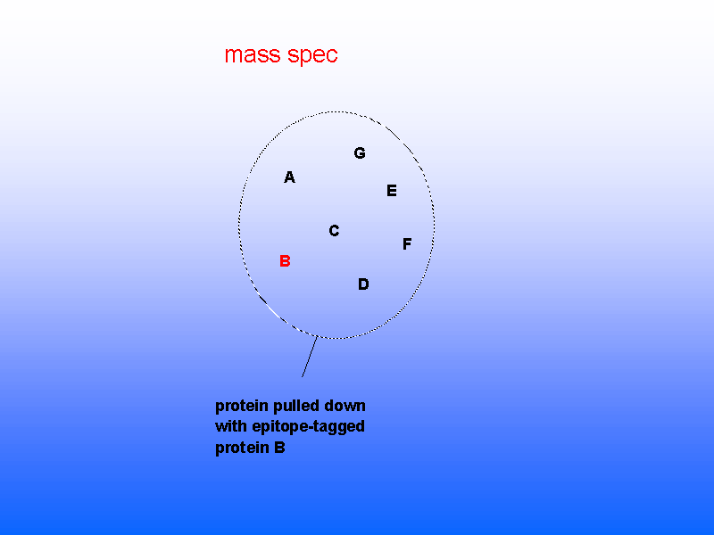
Gavin et al. (2002) Nature 415:141

Slide 6
Matrix method (two hybrid)
From: TRENDS in Genetics Vol.17, No.6, June 2001.
Notes:
There three ways of two-hybrid system.
First is Uetz’s protein array method, they detect interaction one by one.
they use 192 baits X 6000 preys.

Slide 7
Interaction Sequence Tags (ISTs)
From: Nature 405, June 15, 2000, 837-846.
Notes:
The second is interaction sequence tag method. after the proteins are fused to binding-domain (bait) or activation domain (prey), they are put into pools for mating, then sequenced the active ones to find the interacting genes.
both groups use this strategy. I will list the data later.
-----------------------------------------------------------------------------------------------------------------------------
Library-based yeast two-hybrid screening method. In this strategy,
two different yeast strains containing two different cDNA libraries are prepared. In
one case, the ORFs are expressed as GAL4-BD fusions and in the other case, they
are expressed as GAL4-AD fusions. The two yeast strains are then mated and
diploids selected on deficient media. Thus, only the yeast cells expressing
interacting proteins survive. The inserts from both the plasmids are then sequenced
to obtain a pair of interacting genes.

Slide 8
Two data sets from yeast two hybrid system
Uetz’s data (Uetz et al. 2000).
Ito’s data (Ito et al. 2000, 2001).

Slide 9
Possible Errors in 2-hybrid system
False positive.
Possible mutation during PCR-amplifying.
Stochastic activation of reporter gene.
False negative.
Membrane protein, post-translational modification protein, those self-activating reporter genes (Removed in experiment).
Weak interactions.
The size of interactome for yeast (5-50/protein)
Notes:
it should be noted that two-hybrid system contain errors.
(false positive and false negative, these are some reasons.)
It’s believed that the interacting pairs are more than what we know now. One estimation is 5-50/protein, that’s 30,000-300,000 interacting pairs for Yeast.

Slide 10
Estimate the reliability of the experimental data
Reference:
Minghua Deng, Fengzhu Sun and Ting Chen. Assessment of the reliability of protein-protein interactions and protein function prediction. Pacific Symposium on Biocomputing 2003: 140-151.

Slide 11
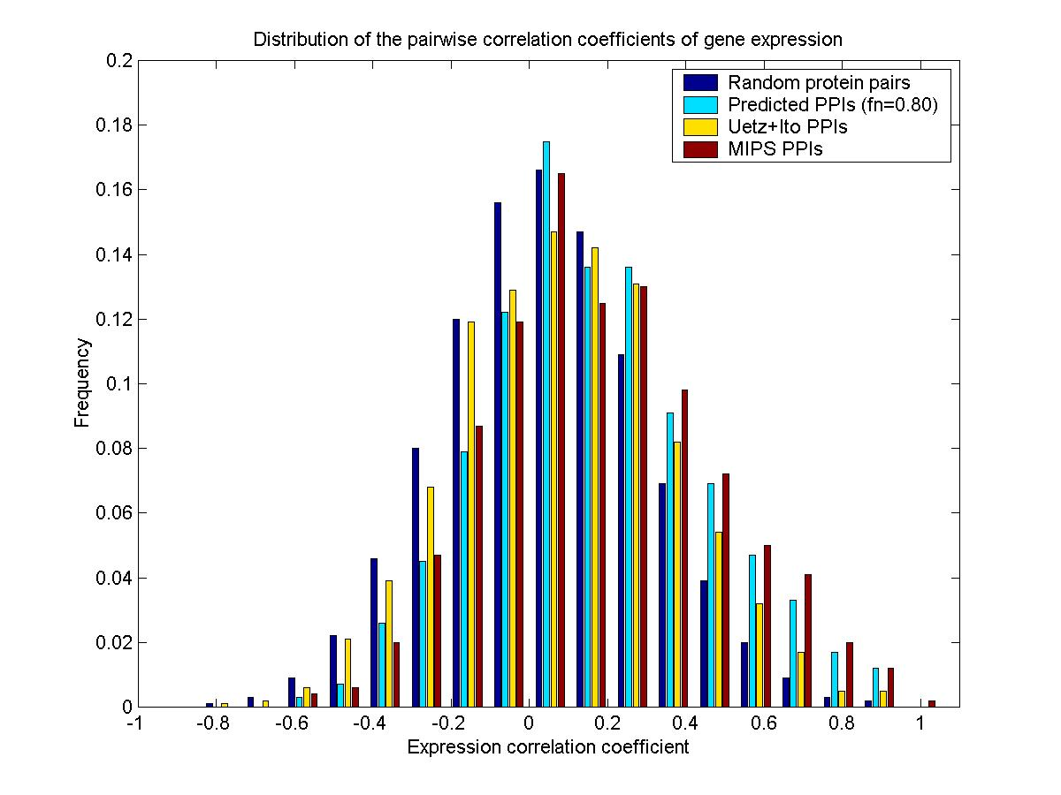
Notes:
This graph show the distribution of pairwise expression correlation coefficient.
Horizontal axis is expression correlation coefficient, range from –1.0 to 1.0
The blue one is for random protein pairs, green for our prediction and red one for MIPS interaction data.
we can see that our prediction as well as MIPS data have a positive shit of
expression correlation. and the shit in MIPS is much biger that our prediction.

Slide 12
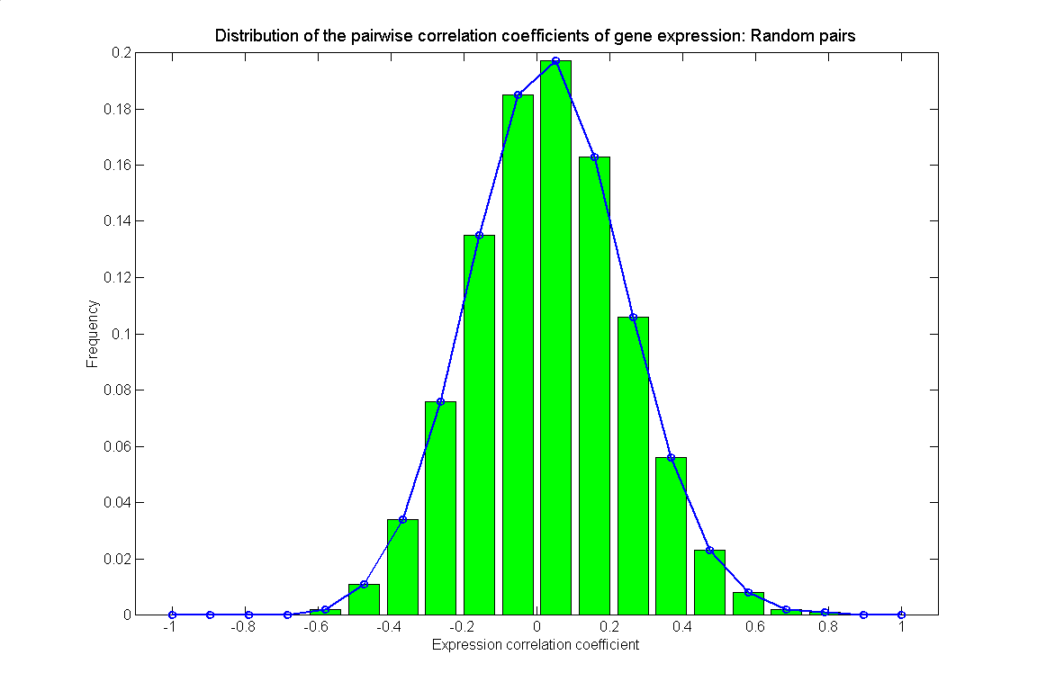
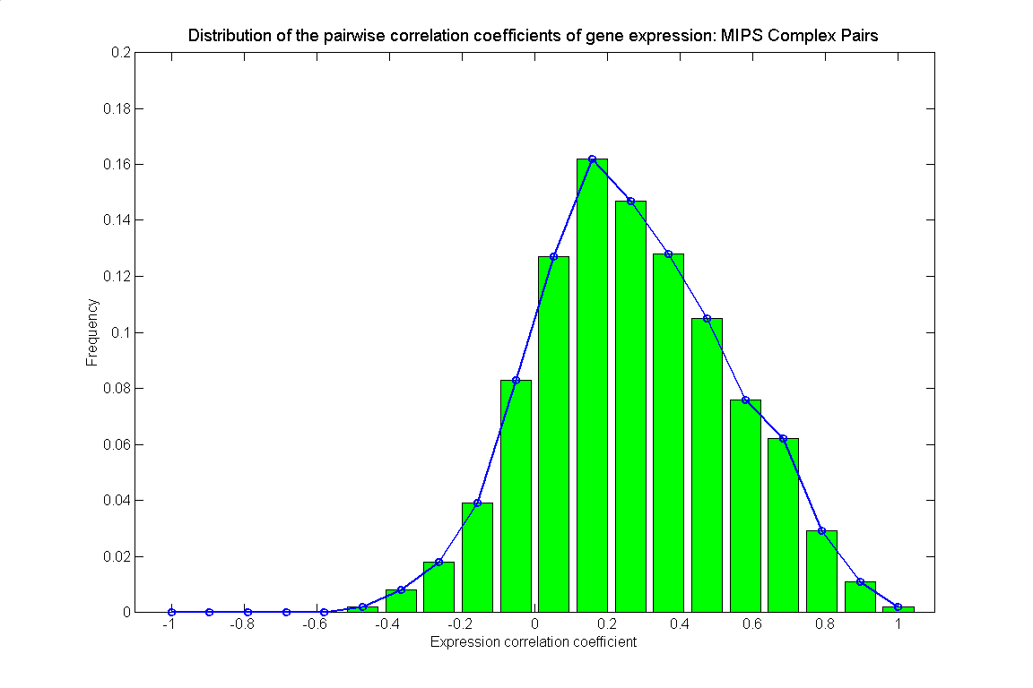
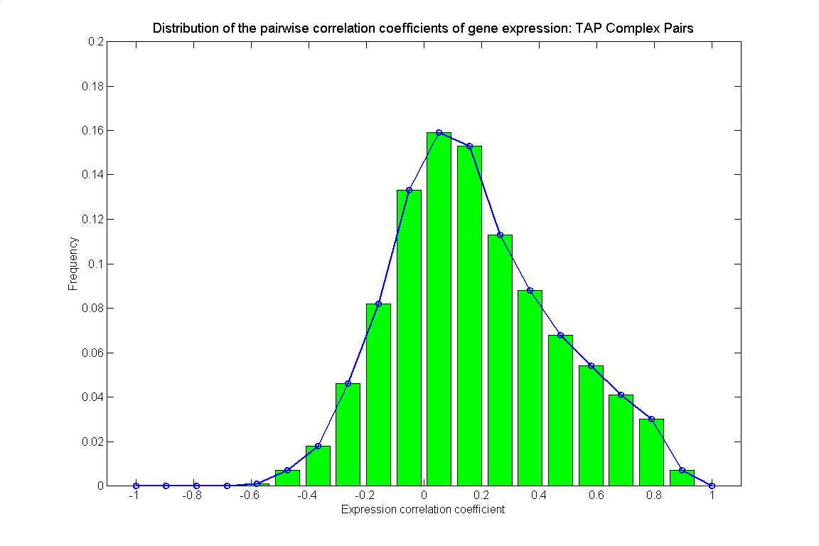
Non-interaction
Real interaction
Observed interaction data
Notes:
This relation can be shown in the following figure.

Slide 13
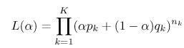
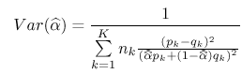
MLE of the reliability
Likelihood function
Precision of the estimation
Notes:
This slide show our maximum likehood estimation method.
For simplicity, we bin the correlation coefficient. suppose we use K bins,
let nk be the number of observed interaction pairs in the kth bin, pk and
qk are the fractions of real interactions and random pairs in the kth bin,
respectively. The likelihood function is given as following, we estimate
alpha to maximize this likelihood function. And the precision of the estimation
is given as following formula.

Slide 14
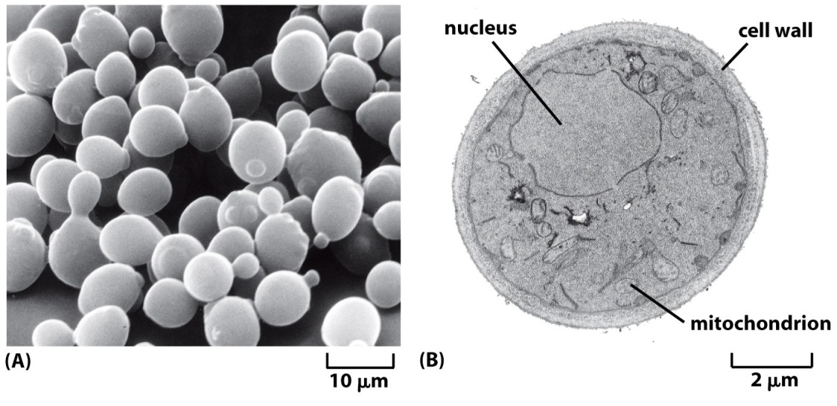
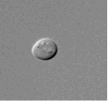
Budding Yeast Saccharomyces Cerevisiae
a and α mating type, cell cycle
6300 genes (1997)
Genome-wide single mutants analysis (2000~)

Slide 15
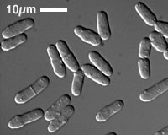
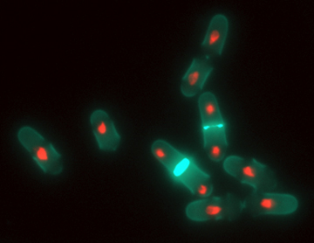
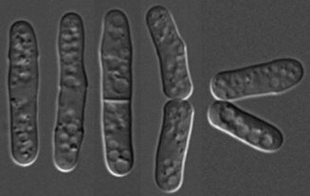
Fission yeast Schizosaccharomyces Pombe
1000 million years separation from budding yeast;
13.8 Mb genome size, 4824 genes (open reading frames, OPF);
3 chromosomes, no genome-wide duplications; h+ and h- mating types;
Cell cycle: 10% G1, 10% S, 70% G2 and 10% M phases.
Genome-wide single mutants analysis (2010~)
more similar to metazoans than S. cerevisiae
cell cycle regulation in G2/ M phase,
gene regulation by the RNAi pathway
the widespread presence of introns in genes
Notes:
metazoan
[9metE`zEJEn]
n.
[动]后生动物, 多细胞动物
adj.
后生动物的, 多细胞动物的
jid
15

Slide 16
What’s Genetic Interaction
Genetic interactions between two loci can be mapped by measuring how the phenotype of an organism lacking both genes (double mutant) differs from that expected when the phenotypes of the single mutations are combined
Null model: F(ΔAB)= F(ΔA)* F(ΔB)
Null model: F(ΔAB)= F(ΔA)* F(ΔB)
Beltrao et al. Cell 141: 739-745, 2010.

Slide 17
Identification of Genetic Interactions
Synthetic Gene Array (SGA) (Tong, et al. 2001)
Diploid based Synthetic Lethality Analysis on Microarrays (dSLAM) (Pan, X., et al. 2004)

Slide 18
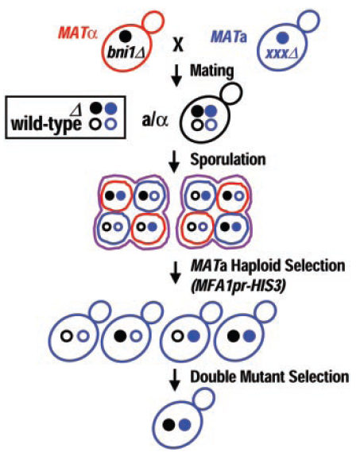
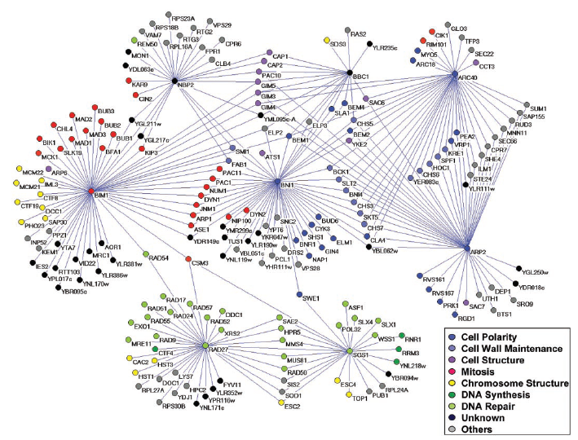
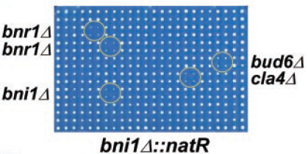
Synthetic Gene Array (SGA)
Synthetic genetic array methodology
Genetic Interaction Network
Final Screen
Amy Hin Yan Tong, et al. Science, 2001.

Slide 19
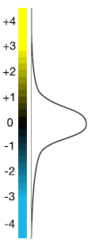
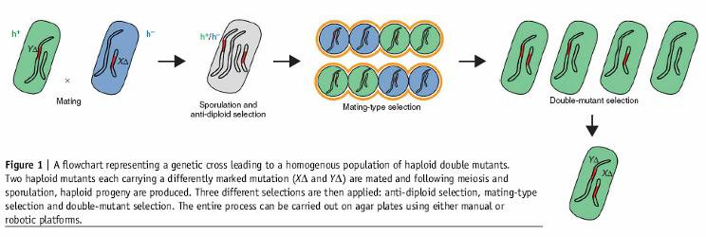
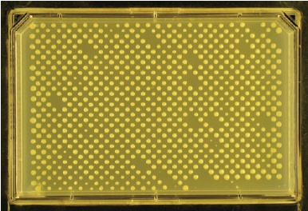
EMAP is the Extension of SGA
EMAP: Epistatic Miniarray Profiles (Maya Schuldiner, et al. 2005. Cell)
Quantitative measurement of phenotype (colony size)
Measure both positive and negative interactions.
Genome-wide (DAMP for lethal genes ).
Dorothea Fiedler, et al. Cell, 2009

Slide 20
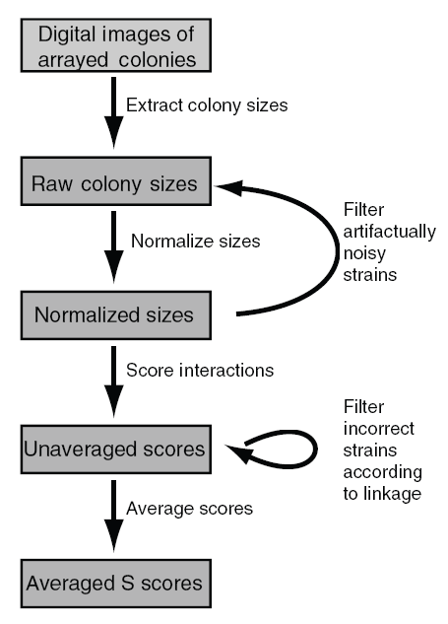
EMAP S-score
Quantitative measure:
T-Test with null hypothesis
No interaction | Synthetic sick/Lethality | Synthetic alleviating
Sean R Collins, et al. Genome Biology 7: R63, 2006.

Slide 21
PPI databases
MIPS: Munich Information center for Protein Sequences (http://mips.gsf.de)
DIP: Database of Interacting Proteins (http://dip.doe-mbi.ucla.edu)
BIND: Biomolecular Interaction Network Database (http://www.bind.ca)
GRID: General Repository for Interaction Datasets (http://biodata.mshri.on.ca/grid)
MINT: Molecular Interaction Database (http://cbm.bio.uniroma2.it/mint/)

Slide 22
Further Reading
For more experimental methods and databases, please read the following review paper
Shoemaker BA, Panchenko AR (2007) Deciphering Protein–Protein Interactions. Part I. Experimental Techniques and Databases. PLoS Comput Biol 3(3): e42. doi:10.1371/journal.pcbi.0030042.

Slide 23
Protein-protein interactions (Computational Methods)
Gene fusion method (A.Enright 1999. E.Maccote 1999)
Phylogenetic profile method (M.Pellegrini 1999, D.Eisenberg, 1999).
Gene cluster method (R.Overbeek, 1999).
Highly co-expressed gene pairs.
Notes:
The first two method derive possible functional links between proteins just by sequence.
The third is a pure machine learning method.
The fourth use domain interaction data of H.Pylori to predict PPI for E.Coli.
And the last one share some kind of idea as us, but they paid more attention on the topology of interaction network.

Slide 24
Part II: Predicting Protein-protein Interactions
Some computational methods
Predicting protein-protein interaction from domains
Association method
MLE method

Slide 25
Rosetta Stone Method
From: Nature Vol. 405, June.15, 2000, 823-826

Slide 26
Phylogenetic Profiles Method
From: Nature Vol. 405, June, 15, 2000, 823-826
Notes:
They collect all genes in different genome, and build a phylogenetic profile by an 0-1 matrix indicate each gene appears in different
Genomes or not. Then they cluster profiles, if two genes are clustered together, they conclude these two genes are functionally linked.

Slide 27
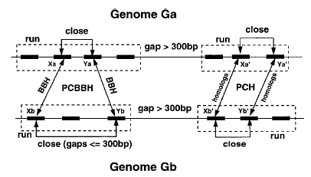
Using Gene Clusters to Infer Functional Coupling
From: R.Overbeek, PNAS 96, 2896-2901, 1999.

Slide 28
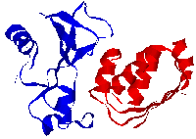
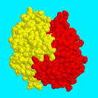
Structure of Proteins
Notes:
Please bear in mind, proteins are with 3D structures.

Slide 29
Predicting PPIs from Domains
Domains are treated as elementary unit of function.
Domains are responsible for the generation of interactions.
Understanding protein-protein interaction at the domain level.
Notes:
Now I turn to our model. First why we study domain-domain interaction.
Since domain can be treated as the elementary unit of function. So understanding the domain-domain interaction will help us
Understand the protein-protein interaction. That’s the basic idea behind our project.

Slide 30
Domain Databases
Pfam, domain classification by HMM.
Prodom.
PRINTS, fingerprint information of protein sequences.
SMART, mobile domain.
BLOCKs, multiple alignment blocks.
Interpro.

Slide 32
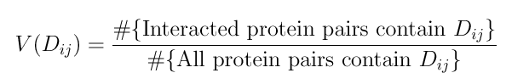
Association-A simple method
More observed PPIs for one domain pair will give higher probability of interaction for that domain pair.
Notes:
We use two method. One is Association method (maybe a naïve method). The other is probability method.
For association method. We just count the frequency that domain-domain pairs within the interacted the protein-protein pairs.
More observed PPIs for one domain pair will give higher probability of interaction for that domain pair.The formula is given as.

Slide 33
Simple Example
By assoiation method:
Others are 0.0.
D15: {P34, P35, P15, P14}.
Notes:
One simple example.
Without interaction data of P1 and P2, it looks like D1 (or D2, D3) and D4 (or D5, D6) equally interacts. When data of P1 and P2 entering, the differences appear. However, the association method cannot make this difference clearly.
D5 interact with D1 (or D5).

Slide 34
Limitation of Association Method
For multiple-domain proteins, this method computes the value for a certain domain pair ignoring the value of other domain-domain pairs. So it’s a local one.
This method cannot deal with possible error of the data.
Notes:
obviously, this naive method have a certain limitation.
one is for multiple-domain proteins, it compute that value for each domain pairs independently.
and the big problem is that it cannot deal with false positive and false negative in data.

Slide 35
Probabilistic Model
Domain-domain interactions are independent, which means that the event that two domains interact or not does not depend on other domains.
Two proteins interact if and only if at least one pair of domains from the two proteins interact.
Notes:
Now I introduce our probability method.
First we make following assumption.

Slide 36
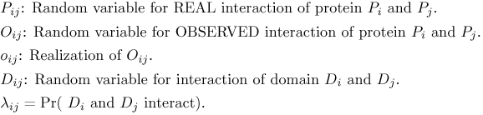
Some Notations
Notes:
Since we consider false positive and false negative, we emphasize the difference between
Real interaction and the observed interaction.

Slide 37
Probabilistic Model (Cont.)
Notes:
Base on our assumption, the probability of two protein interact is give by the following formula.
In the multiplication, we consider all possible domain pairs.

Slide 38
Modeling the Possible Errors
Notes:
And we can put the possible error into our model, we introduce two parameters
to describe the error in observation data. false positive and false negative.
False positive, not a real interaction but observed.
False negative, it’s a real interaction but not observed.

Slide 39
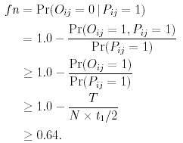
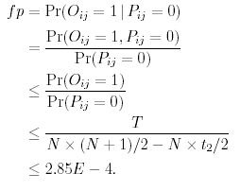
Estimation of fp and fn
Real interactions: 5-50/protein, t1=5, t2=50;
Observed interactions: T=5719 (Uetz+Ito)
Proteins: N=6359 (SGD).
Notes:
we can estimate the false positive and false negative by the knowledge of the size of
interactom.

Slide 40
Likelihood Function
Notes:
First formula shows the probability of observed interaction related to real interaction and false positive and false negative.
Second formula shows the likelihood function, i.e. the probability that we observed such interacting pairs.

Slide 41
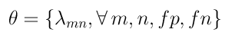
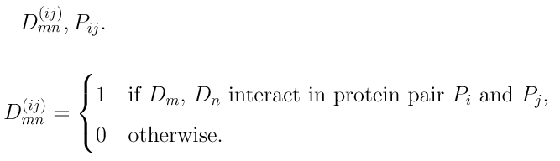
Missing Data Problem
Parameters:
Missing data:
Notes:
This is a missing data problem. The missing data are domain-domain interaction within a certain protein pair and the real protein-protein interaction.

Slide 42
General EM Algorithm
Observed data Y
Missing data X
Complete data Z=(Y, X).
E-step (expectation).
M-step (maximization).
Notes:
We use EM algorithm to solve this MLE problem.
Given the observation data, and missing data, we can construct complete data.
EM algorithm contains two step.
In E-step, we compute the expectation of complete data based on observation and current
Estimation of parameters.
In M-Step, we use the esitimated complete data to maximize the parameters.

Slide 43
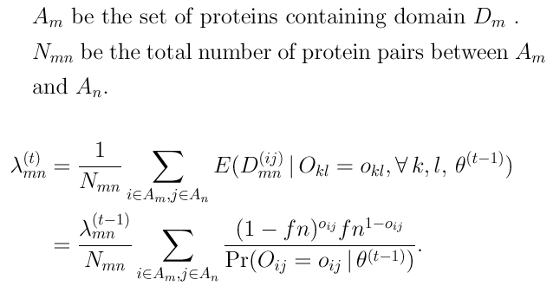
Parameters Re-estimation (1)
Notes:
the formula is given as following. Simply, it can be thought as the frequency of interacted
domain pairs.

Slide 44
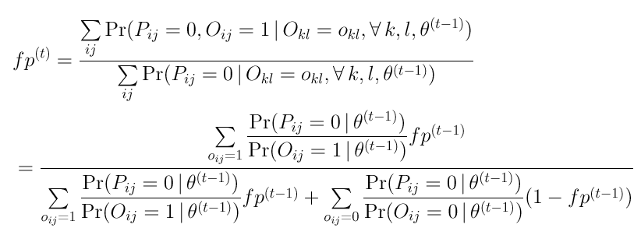
Parameters Re-estimation (2)

Slide 45
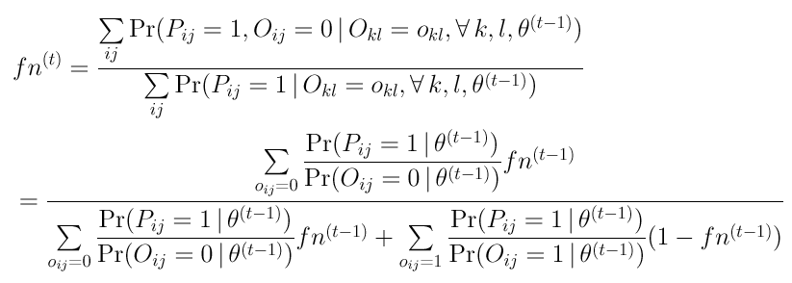
Parameters Re-estimation (3)

Slide 46
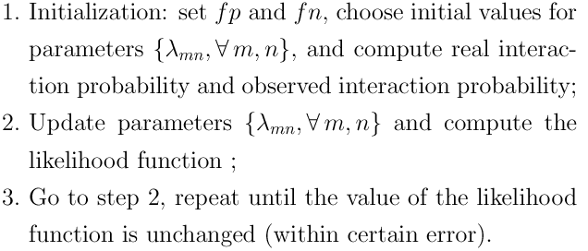
Algorithm

Slide 47
Flow Chart
Notes:
when domain-domain interactions are learned. we can use it to predict protein-protein interaction.
and compute a certain specificity and sensitivity. the flow chat is as this.

Slide 48
Yeast Data
Interactions (Uetz’s and Ito’s interaction data).
Domain: Pfam (Pfam-A, Pfam-B).
Proteins: SGD, N=6359.

Slide 49
Protein Interaction Data Sources
 | Proteins | Pfam domains | Super -domains | PPI
Uetz | 1337 | 1330 | 313 | 1445
Ito | 3277 | 2776 | 909 | 4475
Uetz+Ito | 3729 | 3124 | 1007 | 5719
Overlap | 855 | 964 | 215 | 201
Notes:
We use protein-protein interaction data and Pfam domain data.
These are some numbers of the data. 1445*4475/201=

Slide 50
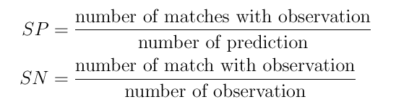
Measure the Accuracy
Specificity and sensitivity.
Verification by MIPS physical interactions (as TRUE interactions).
Relationship between protein-protein interactions and expression data.
Notes:
I’ll illustrate our results from following 4 calculation.

Slide 51
Notes:
this graph showed that MLE method is superior to association method.
Since we fix fn=0.85. We predict more novel protein-protein interaction, so the specificity cannot
Be very high.

Slide 52
Notes:
Even the probability value can change when we use different fp and fn, the relative rank not change two much, so we can get robust specificity and sensitivity.

Slide 53
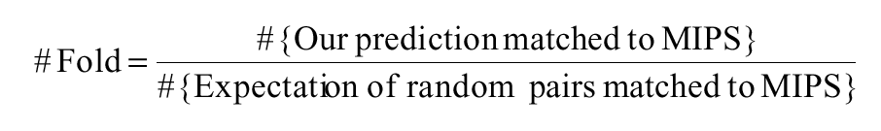
Verification by Known PPIs
MIPS physical interaction. (Totally 2570 PPIs, 1414 PPIs not overlapping with our training set).
Compare with random matching.
Fold number
Larger fold number imply more reliable prediction
Notes:
Then we test our prediction by finding the overlap with MIPS physical interaction.
The MIPS database collect experimentally verified data. We use it as test data to verify
Our prediction. For testing, we excluding those overlap with training set.
We count the matching PPIs. To compare our matching and matching by chance? We define this fold number.

Slide 54
Matching with MIPS PPIs
Prob | #Predict | #Train | #MIPS |  | #Fold
All | 20221620 | 5719 | 2570 | 1414 | 1.00
>0.00 | 136463 | 5719 | 1265 | 109 | 11.92
>=0.20 | 26908 | 5238 | 1093 | 53 | 34.97
>=0.40 | 19360 | 5018 | 1035 | 48 | 47.85
>=0.60 | 14725 | 4775 | 971 | 47 | 67.53
>=0.80 | 12734 | 4647 | 932 | 43 | 76.02
>=0.975 | 10824 | 4461 | 886 | 40 | 89.88
Notes:
This table showes the number of matching.
We can see that with the high threshold, the fold number is high, and the prediction is more reliable.

Slide 55
Interaction Data Correlated With Gene Expression Data
Interacted proteins seems to have high expression correlation
A.Grigorieve Nucleic Acid Res. 29, 2001;
H. Ge et al. Nature Genetics 29, 2001;
R. Jansen et al. Genome Res.12, 2002.
Expression data (M.Eisen, 1998); 2465 Yeast ORFs with 79 data points/ORF.
Pearson correlation coefficient.
Notes:
Finally, we use gene expression data to verify our prediction.
It’s was reported that interacted proteins show high expression correlation.
We use the expression data. 2465 genes X79 data points. And we use pearson correlation coefficient.

Slide 56
Notes:
This graph show the distribution of pairwise expression correlation coefficient.
Horizontal axis is expression correlation coefficient, range from –1.0 to 1.0
The blue one is for random protein pairs, green for our prediction and red one for MIPS interaction data.
we can see that our prediction as well as MIPS data have a positive shit of
expression correlation. and the shit in MIPS is much biger that our prediction.

Slide 57
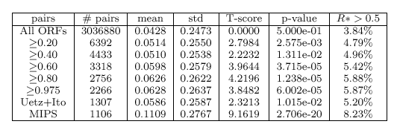
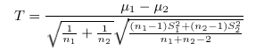
Statistics of Pairwise Correlation of Gene Expression
Notes:
this shift can be seen clear by following statistics.
The first line are used as control.

Slide 58

Discussion
Independent assumption, high order domain interaction is possible, need more parameters.
Pfam-A and Pfam-B are in different level.
Insufficient experimental data.
Notes:
finally discussion for our model.

Slide 59
Related Works
Inferring domain-domain interactions
Riley et al. Genome Biol. 2005.
Lee et al. BMC Bioinformatics, 2006

Slide 60
References
M. Deng, S. Mehta, F. Sun, T. Chen (2002) Inferring domain–domain interactions from protein–protein interactions, Genome Res. 12: 1540–1548.
H. Lee, M. Deng, F. Sun, T. Chen (2006) An integrated approach to the prediction of domain–domain interactions, BMC Bioinform. 7:269.
R. Riley, C. Lee, C. Sabatti, D. Eisenberg (2005) Inferring protein domain interactions from databases of interacting proteins, Genome Biol. 6:R89.
Shoemaker BA, Panchenko AR (2007) Deciphering Protein–Protein Interactions. Part I. Experimental Techniques and Databases. PLoS Comput Biol 3(3): e42. doi:10.1371/journal.pcbi.0030042.
Shoemaker BA, Panchenko AR (2007) Deciphering Protein–Protein Interactions. Part II. Computational Methods to Predict Protein and Domain Interaction Partners. PLoS Comput Biol 3(4): e43. doi:10.1371/journal.pcbi.0030043.
Hung Xuan Ta, Liisa Holm(2009) Evaluation of different domain-based methods in protein interaction prediction. Biochemical and Biophysical Research Communications 390:357–362.

